Slide 1
UnitedTune
Team 2:
Project Manager: John Brilhart
Product Owner: Jay Patel
Lead Business Analyst: Yashwanth Varre, Ge Ou
Lead Developer: Hetali Chavda
DBA: Revati Deshmukh
QA Analyst: Suraj Suwal
Tester: Soyeon Ju
GitHub Repository Slides & Source Code Sample

Slide 2
GitHub URL:
UnitedTune: CS-691-Project

Slide 3
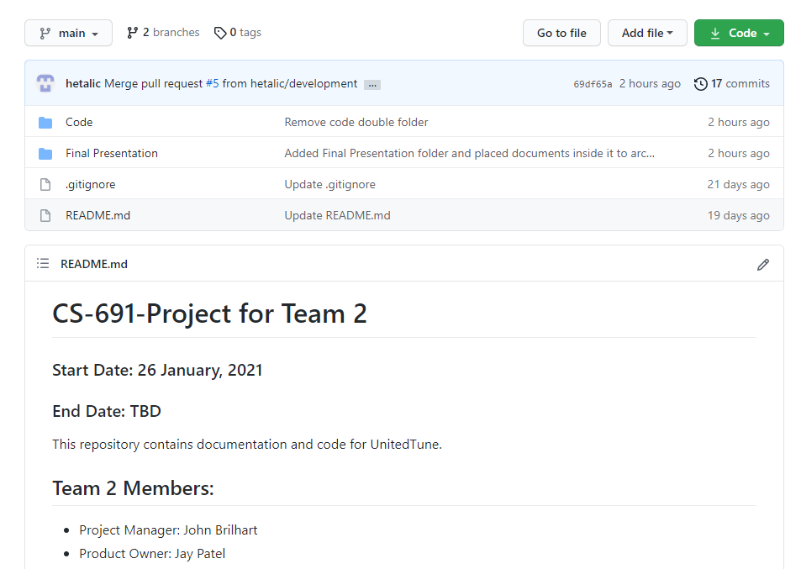
Repository Structure

Slide 4
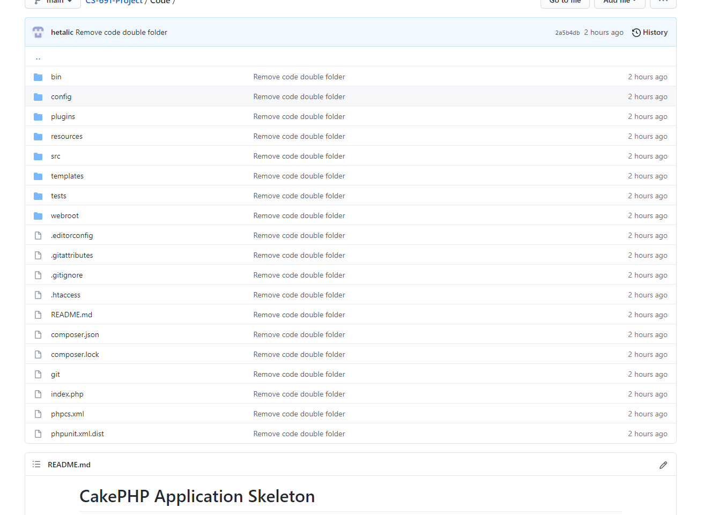
Repository Structure - To Manage Application Code

Slide 5
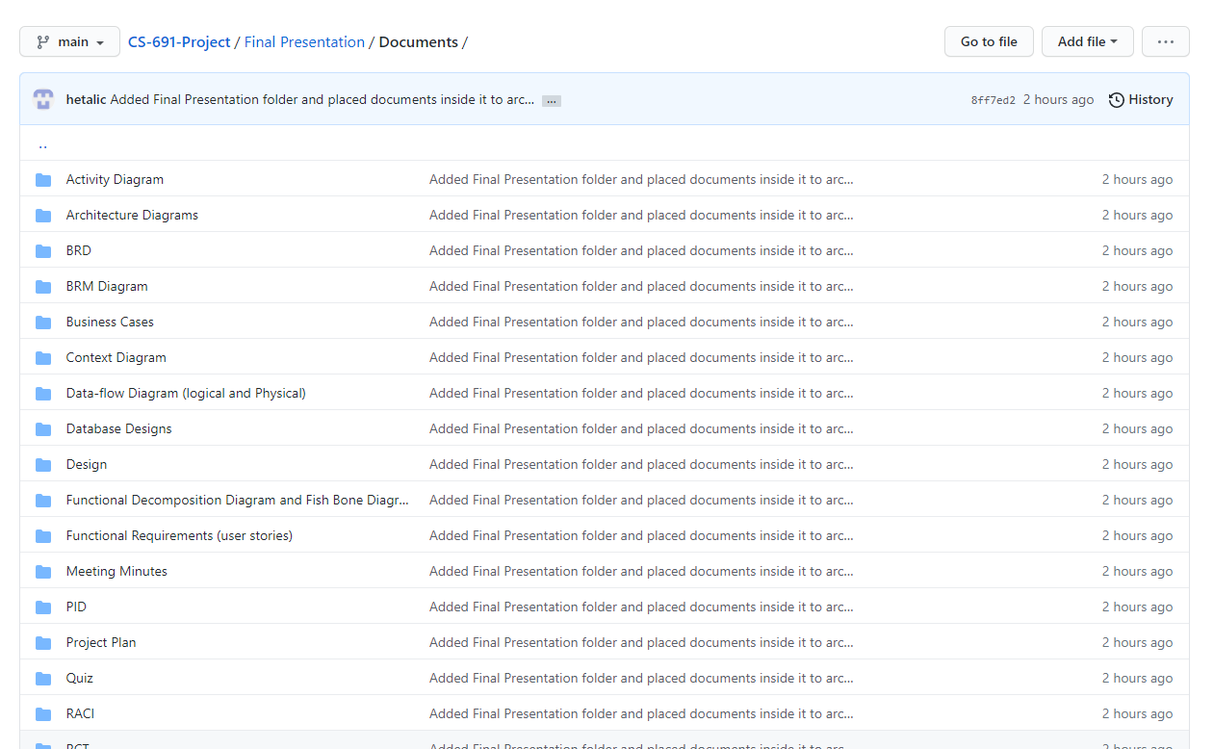
Repository Structure - To Manage Documents

Slide 6
Build & Deployment Procedures:
Prerequisites:
For Windows:
WAMP Server
For Linux:
LAMP Server
Composer
Git

Slide 7
Installation Steps:
Steps:
Download GitHub Repository in your local machine
Create folder “united_tune” into WAMP Servers www folder i.e. “wamp64 > www > ” and place the content of “Code” folder into “united_tune”
Import the database in PHPMyAdmin and change MySQL Database Credentials into united_tune > config > app_local.php if require.
Open browser and run: “http://localhost/united_tune/”

Slide 8
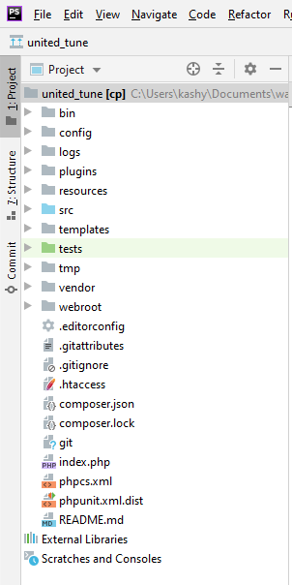
Source Code - Folder Structure

Slide 9
0.1 Customer Account
Features Implemented:
01.01 Register
01.02 Sign In Account

Slide 10
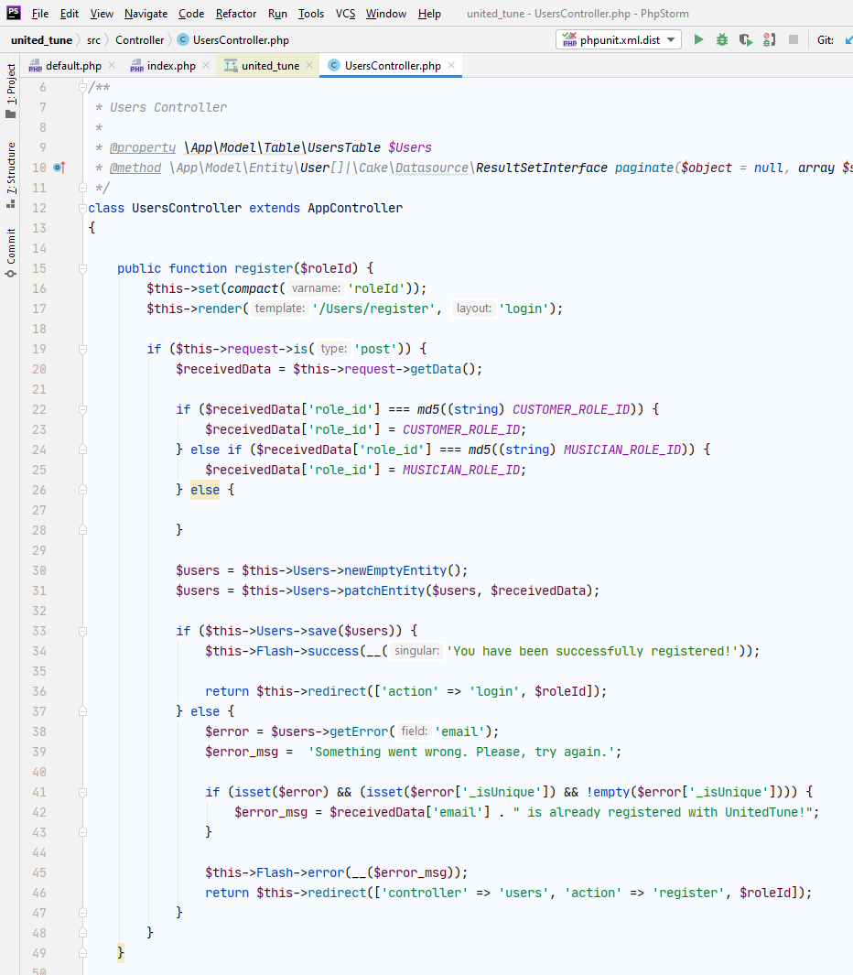
Source Code Sample: 01.01 Register

Slide 11
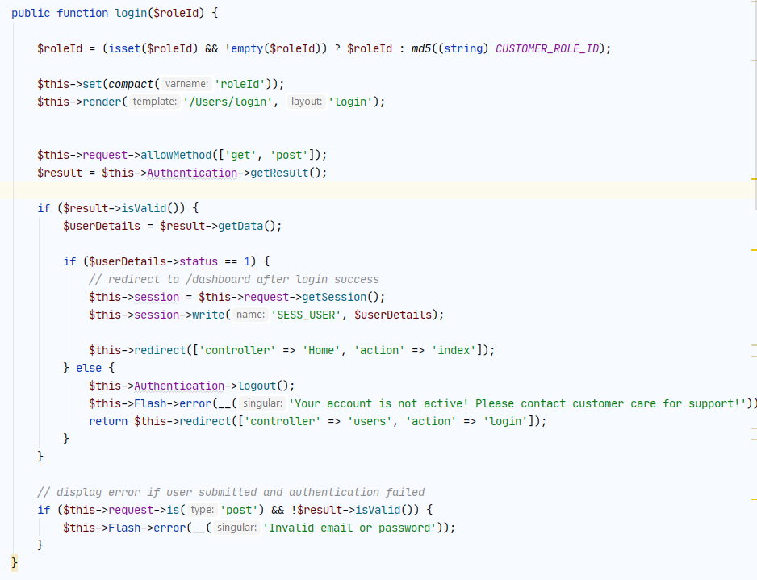
Source Code Sample: 01.02 Sign In Account

Slide 12
0.2 Musician Account
Features Implemented:
02.01 Register Account
02.04 Sign In for Account

Slide 13
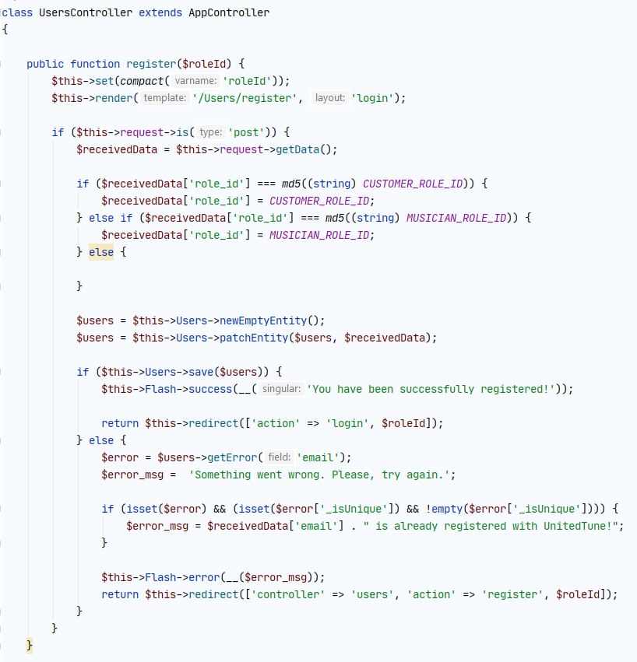
Source Code Sample: 02.01 Register Account

Slide 14
Source Code Sample: 02.04 Sign In for Account

Slide 15
Thank You

